Slide 1
San Francisco Bay Area Chapter Fundraising Management Guide
National Naval Officers Association

Slide 2
SFBA Fundraising Management Guide
The San Francisco Bay Area (SFBA) Chapter of the National Naval Officers Association (NNOA) has established an annual fundraising season that begins with volunteer crowd control services at professional auto racing events starting in May and culminate with an annual crab fest celebration in late February or early March.
This document provides some general discussion about the fundraising events to help facilitate a successful fundraising season. The below list illustrates the chapter’s established fundraising opportunities.
Auto Racing Events
AMA Super Bike Races – Infineon Raceway – May
NASCAR GT350 – Infineon Raceway – June
NHRA Drag Races – Infineon Raceway – July
IZOD Indy Races – Infineon Raceway – August
National Conference Silent Auction
San Francisco 49er Football Event Staff – September thru January
SFBA Crab Fest – February or March
Soliciting Donations

Slide 3
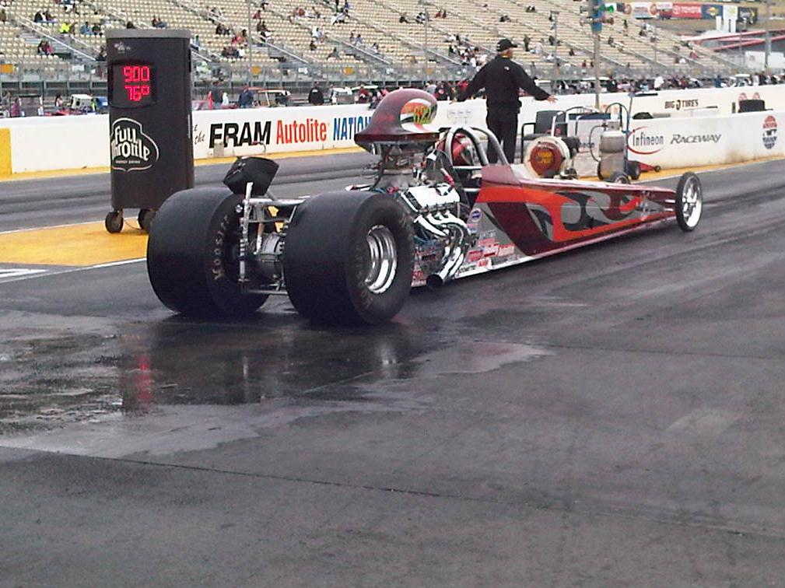
Auto Racing
In 2011, the chapter established a relationship with the Morale Committee at the United States Coast Guard (USCG) Communication Area Master Station Pacific (CAMSPAC) at Point Reyes, CA to assist with volunteer services at professional auto racing events. These opportunities allow CAMSPAC and the chapter to raise money to support the station morale fund and the chapter’s scholarship foundation.
The chapter fundraising coordinator shall maintain close contact with the morale committee chairperson to arrange for and coordinate volunteer support at the annual Infineon Raceway AMA Super Bike, NASCAR, NHRA, and Indy Car racing events, starting in May and ending in August. Notification for support, along with solicitation for participation is normally done 4-5 weeks in advance to give volunteers time to plan and/or adjust their personal schedules.
Participation in these events are in collaboration and cooperation with the Travis AFB Morale Committee. The CAMSPAC morale committee chairperson coordinates directly with the Infineon Raceway Security Chief who informs him of how many volunteers are needed. The CAMSPAC morale committee chairperson solicits volunteers from the chapter and from among station crewmembers.
After contacting the chapter fundraising coordinator, an email is sent to all chapter members asking for their support at the upcoming event. Names are collected and forward to the timekeeper. Attendance details, e.g., attire, reporting times, work details, and specific directions are provided to selected volunteers.
Payment for the hours volunteered usually come about six (6) weeks following the event, and is paid from the CAMSPAC Morale account.

Slide 4
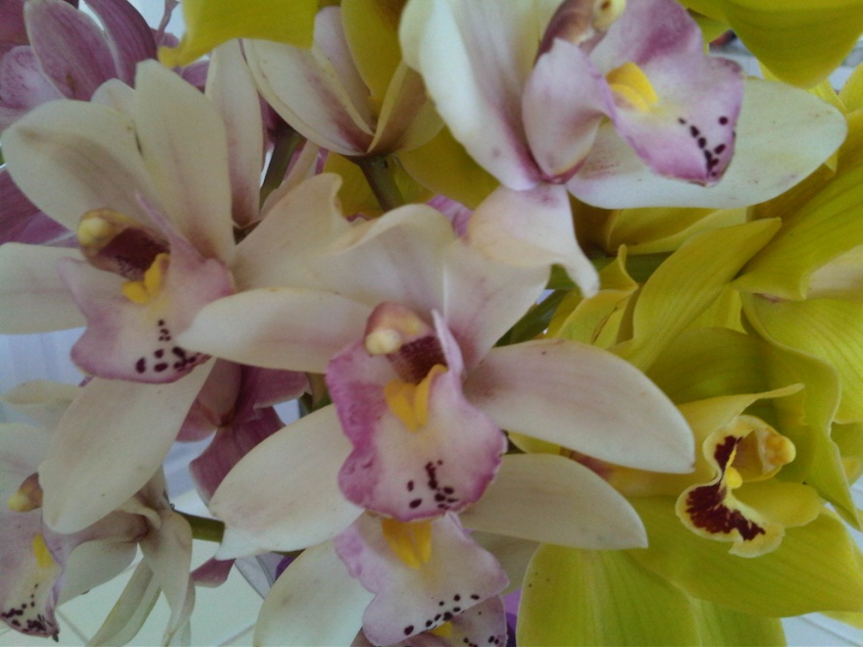
National Conference Silent Auction
Each year, CDR Denise McCallaCreary (Chapter Silent Auction Coordinator) work a silent auction at the national conference to raise money for at the national level and chapter level. Funding returned to the chapter is used to support the chapter scholarship foundation and chapter operating expenses.
Several months before the national conference, Denise solicits donations to be auctioned at the conference. She manages a booth where conference attendees bid on donated items. The highest bidder wins the purchase.
Donated items can include: soaps, coffee, hotel accommodations and/or prizes, home appliances, floral gifts, entertainment coupons, gift certificates, etc., anything that can be sold. The auction coordinator will arrange shipment of small items to the conference. Large items can be auctioned by consignment (pictures, with shipment to be arranged by provider).

Slide 5
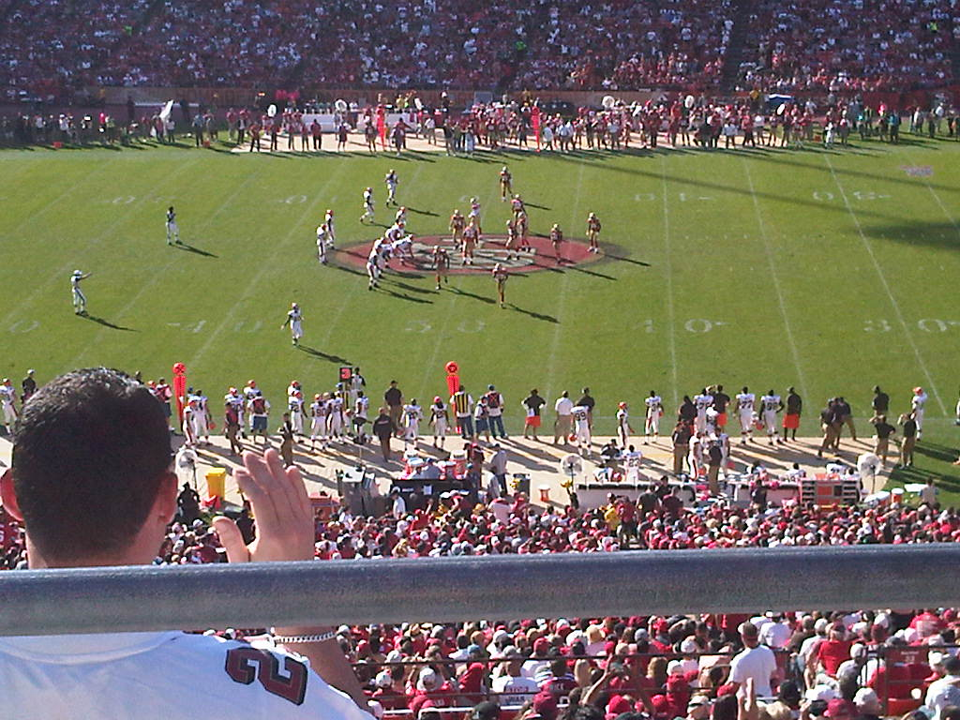
San Francisco 49er Football
In 2011, the chapter established a relationship with the Morale Committee at the United States Coast Guard (USCG) Communication Area Master Station Pacific (CAMSPAC) at Point Reyes, CA to assist with volunteer services at San Francisco 49er professional football games. These opportunities allow CAMSPAC and the chapter to raise money to support the station morale fund and the chapter’s scholarship foundation.
The chapter fundraising coordinator shall maintain close contact with the morale committee chairperson to arrange for volunteer support at 49er home games, starting in September and ending in December – an extended season will depend on the 49ers making the playoffs and having home playoff games. Notification for support, along with solicitation for participation is normally done 2-3 weeks in advance to give volunteers time to plan and/or adjust their personal schedules.
Participation in these events are in collaboration and cooperation with the Travis AFB Morale Committee. The CAMSPAC morale committee chairperson coordinates directly with CDC Security a local company that provides event staff services for the 49ers. The CDC security chief will inform him of how many volunteers are needed. The CAMSPAC morale committee chairperson solicits volunteers from the chapter and from among station personnel.
After contacting the chapter fundraising coordinator, an email is sent to all chapter members asking for their support at the upcoming event. Names are collected and forward to the timekeeper. Attendance details, e.g., attire, reporting times, work details, and specific directions are provided to selected volunteers.
Payment for the hours volunteered usually come about six (6) weeks following the event, and is paid from the CAMSPAC Morale account.

Slide 6
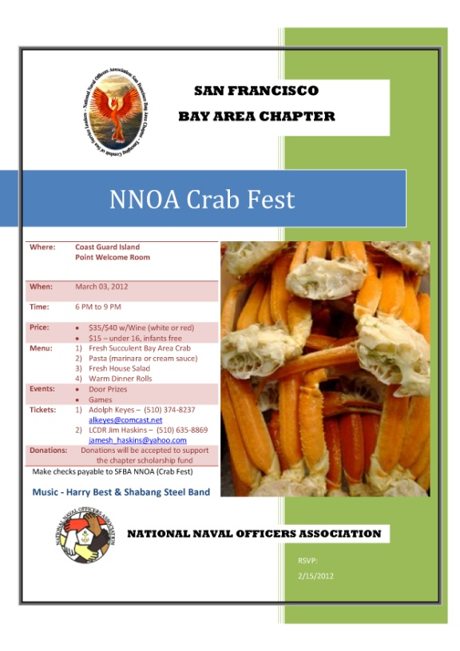
CHAPTER CrAB fEST
To end the chapter fundraising season a crab fest will be given, inviting folks from the surrounding Bay Area communities.
The planning committee should begin meeting and discussing the event, 6-8 months out, but some negotiations should be started earlier, i.e., entertainment, facilities, decorations, and donations.
The planning committee shall reference the crab fest planning guide located on the chapter website. This management tool provides timing and process, an event checklist, and a spreadsheet to develop a budget and menu.
The goals in to have 100-150 guests attend, and the price of ticket sales will be based on the price of crab. Alcohol is permitted but will affect the overall cost of the ticket. The recommendation is $30-$40 a ticket with an extra $5 cost to the alcohol consumer., provided alcohol sale is prohibited.
The planning guide also provide setup diagrams, sample announcement brochure, order of events, (program), and a list of subcommittee needs and procedures., and tips on meeting schedules .
Tax donation forms are included. The crab fest also provides the perfect opportunities for a membership drive, and sample membership forms are included in the guide. Be sure to add donated merchandize, donated services, and cash donations to the gross for tax purposes.

Slide 7
Donations
Letters are sent to prominent business in throughout the Bay Area asking their support for the chapter scholarship foundation. Letters should be mailed in the fall, with an expected return on investment sometime after the new year.
The chapter scholarship chairperson will have the list of local businesses where the donation solicitation will be sent. All letters will be signed by the chapter president and shall include the national tax exempt code.
A copy of the chapter business plan and/or chapter brochure shall accompany the donation request. A sample letter exist in the chapter management tools located on the chapter website.

